Slide 1


Modern C++ Course
Gammasoft

Slide 2

Who am I ?
Gammasoft
Gammasoft aims to make c++ fun again.
About
Gammasoft is the nickname of Yves Fiumefreddo.
More than thirty years of passion for high technology especially in development (c++, c#, objective-c, ...).
Object-oriented programming is more than a mindset.
more info see my GitHub : https://github.com/gammasoft71
Gammasoft
Modern C++ Course

Slide 3
Outline
Introduction
Language Basics
Object Oriented Programming (OOP)
Core Modern C++
Modern C++ Expert
Advanced Programming
Gammasoft
Modern C++ Course

Slide 4
Outline
Introduction
Language Basics
Object Oriented Programming (OOP)
Core Modern C++
Modern C++ Expert
Advanced Programming
Gammasoft
Modern C++ Course

Slide 5
Outline
Introduction
Language Basics
Object Oriented Programming (OOP)
Core Modern C++
Modern C++ Expert
Advanced Programming
Gammasoft
Modern C++ Course

Slide 6
Language Basics
Language Basics
Hello World
Core syntax and types
Arrays and Pointers
Scopes / namespaces
Class and enum types
References
Functions
Operators
Control structures
Headers and interfaces
Auto keyword
Inline keyword
Assertions
Gammasoft
Modern C++ Course

Slide 7
Language Basics
Language Basics
Gammasoft
Modern C++ Course
Hello World
Core syntax and types
Arrays and Pointers
Scopes / namespaces
Class and enum types
References
Functions
Operators
Control structures
Headers and interfaces
Auto keyword
Inline keyword
Assertions

Slide 8
The classic first application
C++98
Language Basics | Hello World
Gammasoft
Modern C++ Course

Slide 9
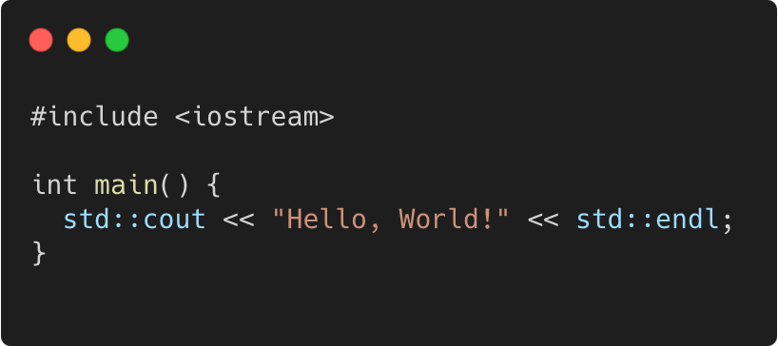
The classic first application
C++98
Language Basics | Hello World
program.cpp
Gammasoft
Modern C++ Course

Slide 10
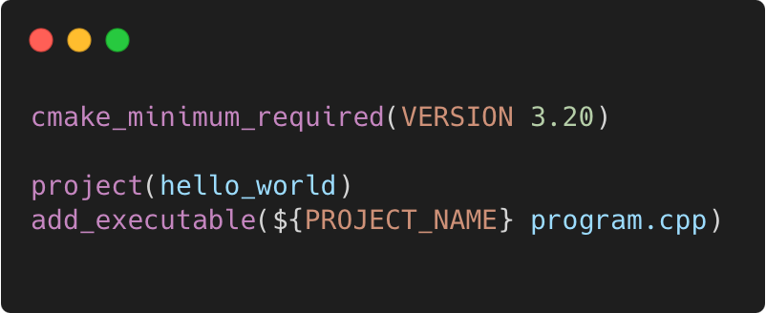
The classic first application
C++98
Language Basics | Hello World
program.cpp
CMakeLists.txt
Gammasoft
Modern C++ Course

Slide 11
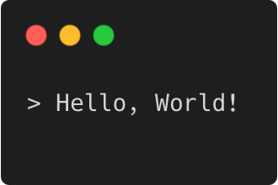
The classic first application
C++98
Language Basics | Hello World
program.cpp
CMakeLists.txt
Output
Gammasoft
Modern C++ Course

Slide 12
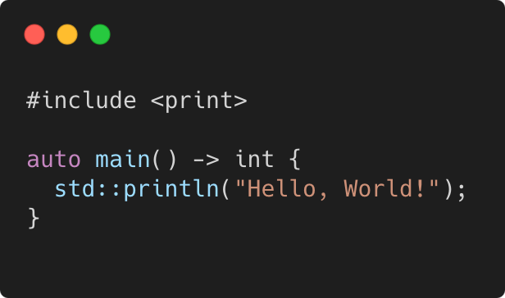
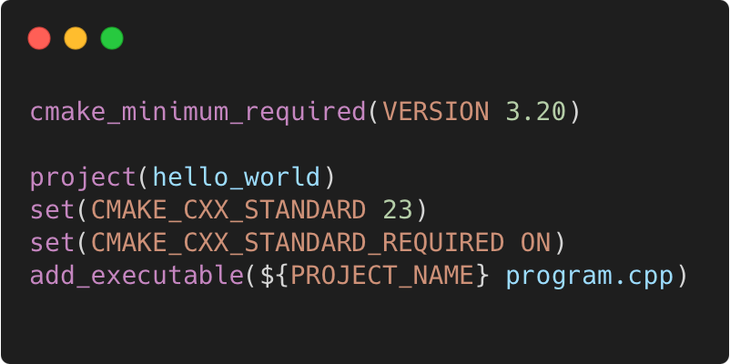
The classic first application
C++23
Language Basics | Hello World
program.cpp
CMakeLists.txt
Output
Gammasoft
Modern C++ Course

Slide 13
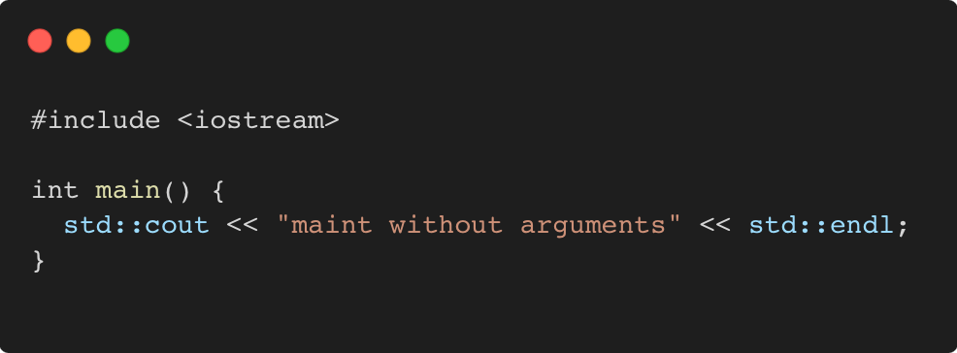
Main function
C++98
Language Basics | Hello World
Gammasoft
Modern C++ Course

Slide 14
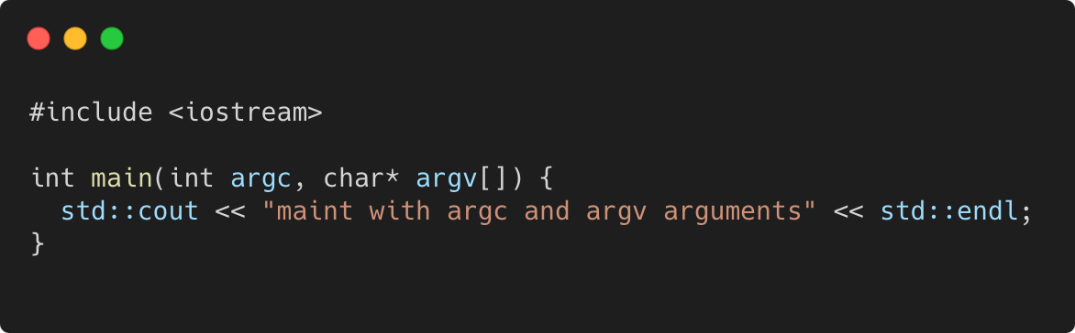
Main function
C++98
Language Basics | Hello World
Gammasoft
Modern C++ Course

Slide 15
Language Basics
Language Basics
Gammasoft
Modern C++ Course
Hello World
Core syntax and types
Arrays and Pointers
Scopes / namespaces
Class and enum types
References
Functions
Operators
Control structures
Headers and interfaces
Auto keyword
Inline keyword
Assertions

Slide 16
Language Basics
Language Basics
Gammasoft
Modern C++ Course
Hello World
Core syntax and types
Arrays and Pointers
Scopes / namespaces
Class and enum types
References
Functions
Operators
Control structures
Headers and interfaces
Auto keyword
Inline keyword
Assertions

Slide 17
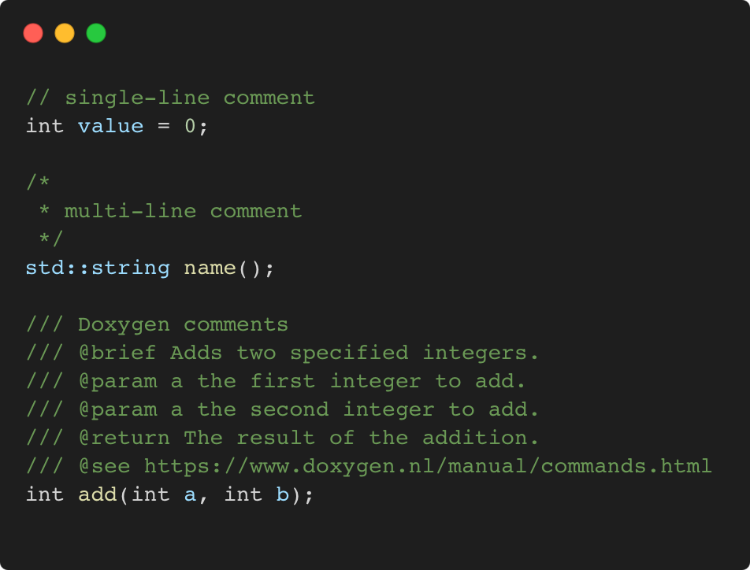
Comments
C++98
Language Basics | Core syntax and types
Gammasoft
Modern C++ Course

Slide 18
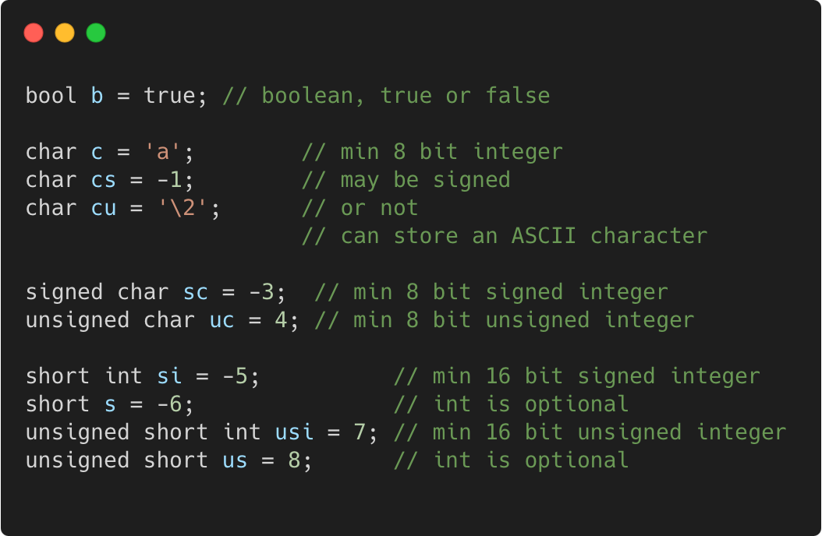
Basic types
C++98
Language Basics | Core syntax and types
Gammasoft
Modern C++ Course

Slide 19
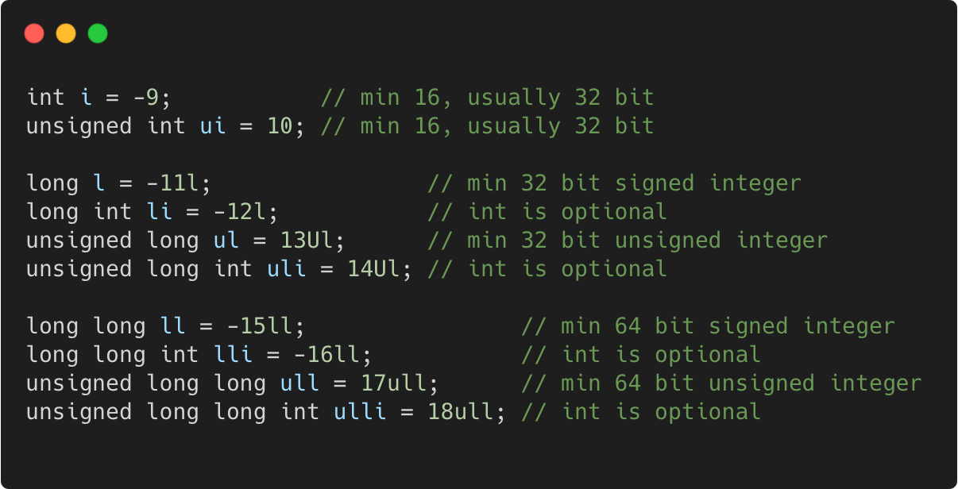
Basic types
C++98
Language Basics | Core syntax and types
Gammasoft
Modern C++ Course

Slide 20
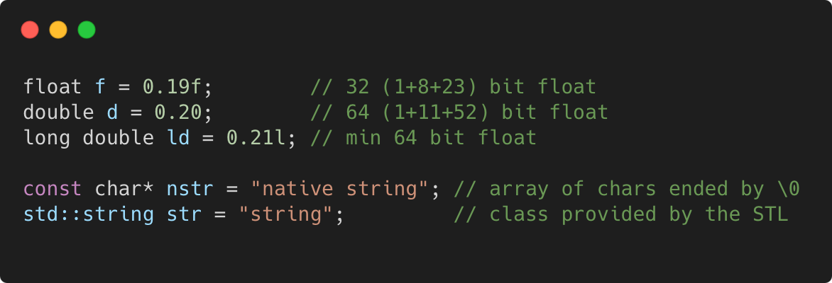
Basic types
C++98
Language Basics | Core syntax and types
Gammasoft
Modern C++ Course

Slide 21
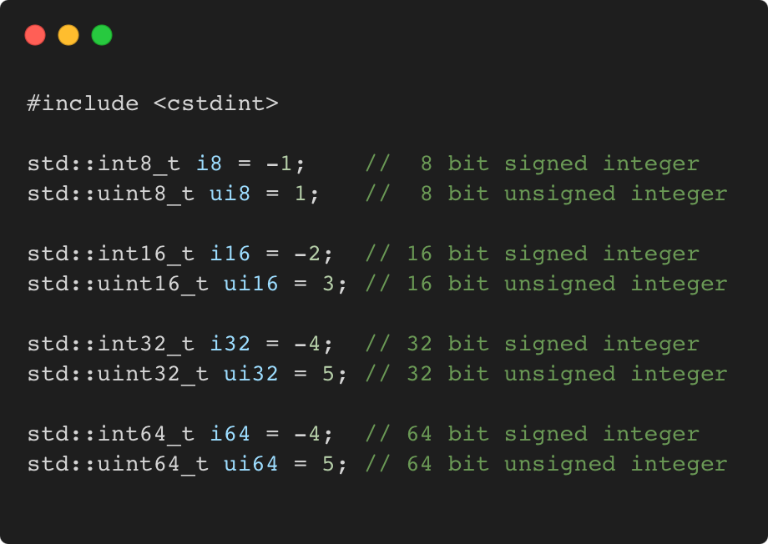
Fixed width integer types
C++11
Language Basics | Core syntax and types
Gammasoft
Modern C++ Course

Slide 22
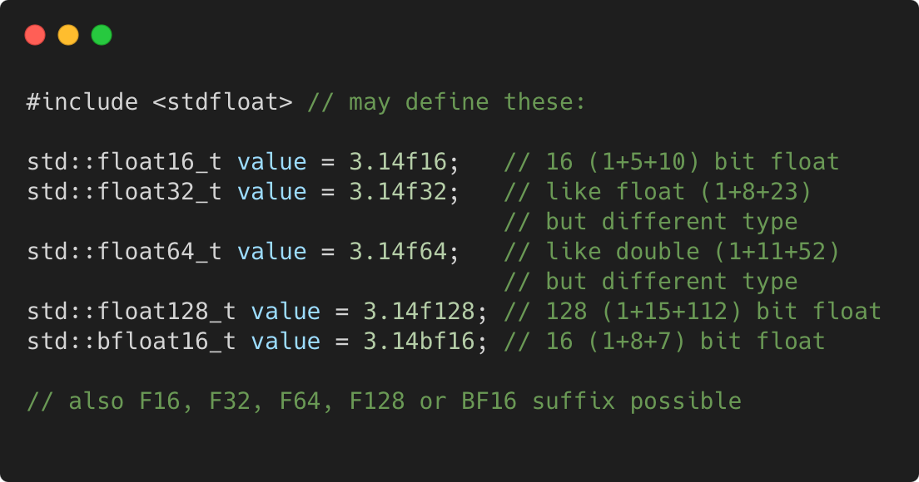
Fixed width floating-point types
C++23
Language Basics | Core syntax and types
Gammasoft
Modern C++ Course

Slide 23
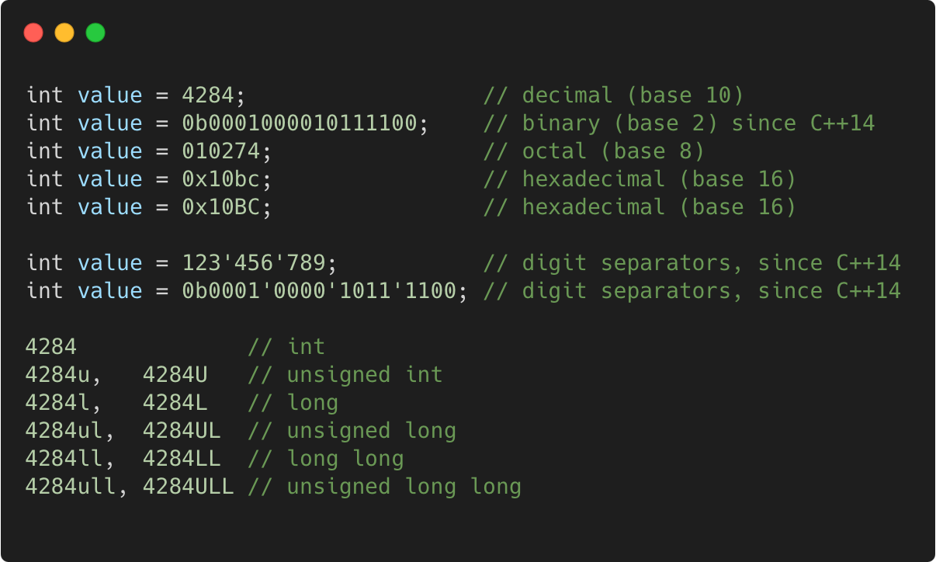
Integer literals
C++98
Language Basics | Core syntax and types
Gammasoft
Modern C++ Course

Slide 24
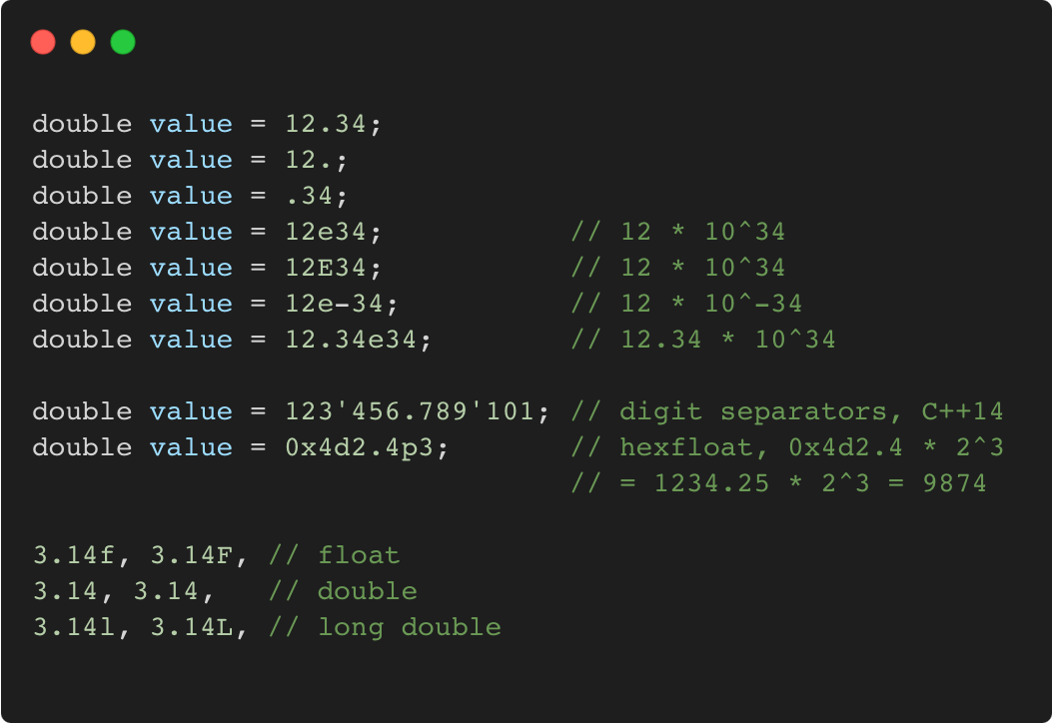
Floating-point literals
C++98
Language Basics | Core syntax and types
Gammasoft
Modern C++ Course

Slide 25
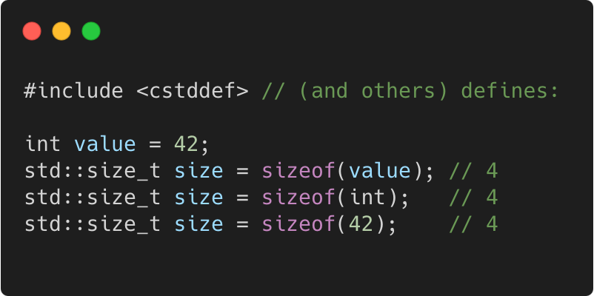
Sizeof
C++98
Language Basics | Core syntax and types
Gammasoft
Modern C++ Course

Slide 26
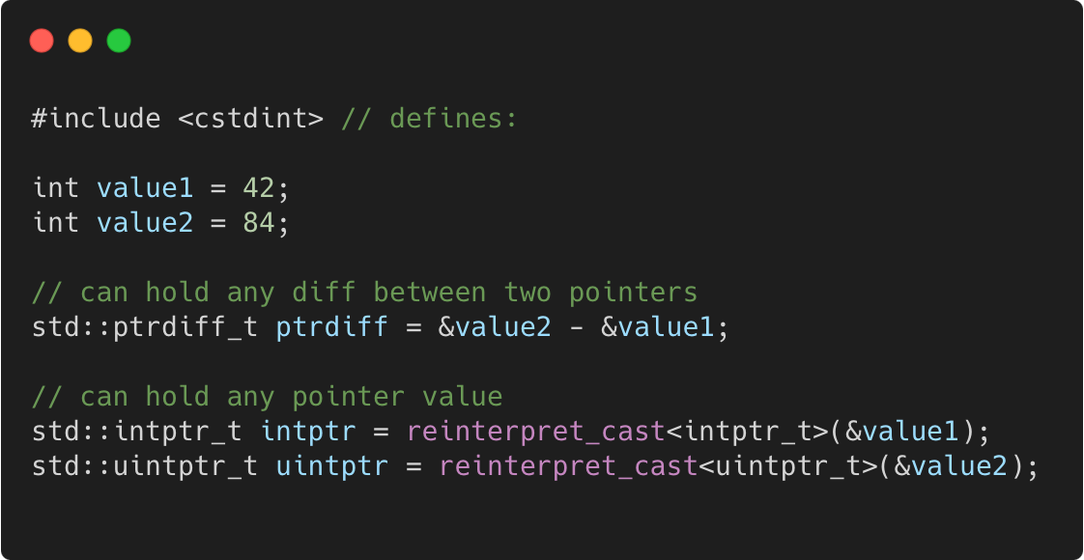
Pointer to integer
C++11
Language Basics | Core syntax and types
Gammasoft
Modern C++ Course

Slide 27
Language Basics
Language Basics
Gammasoft
Modern C++ Course
Hello World
Core syntax and types
Arrays and Pointers
Scopes / namespaces
Class and enum types
References
Functions
Operators
Control structures
Headers and interfaces
Auto keyword
Inline keyword
Assertions

Slide 28
Language Basics
Language Basics
Gammasoft
Modern C++ Course
Hello World
Core syntax and types
Arrays and Pointers
Scopes / namespaces
Class and enum types
References
Functions
Operators
Control structures
Headers and interfaces
Auto keyword
Inline keyword
Assertions

Slide 29
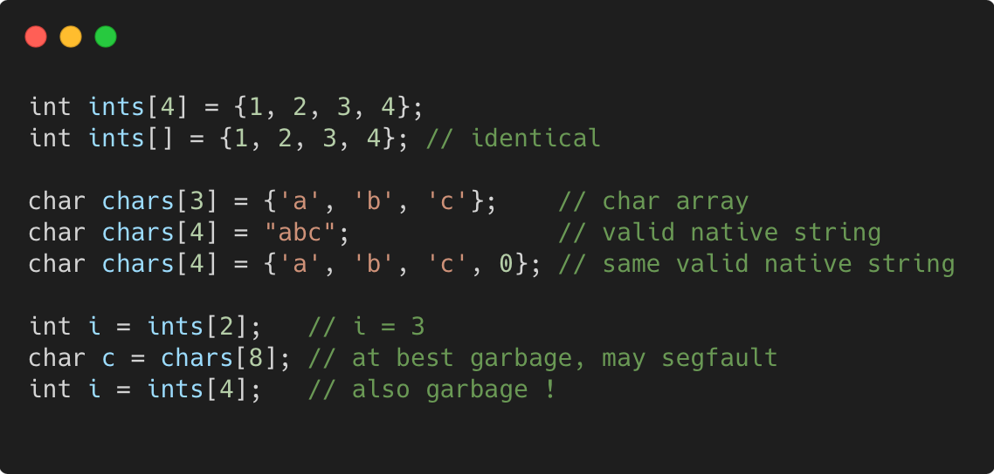
Static arrays
C++98
Language Basics | Arrays and Pointers
Gammasoft
Modern C++ Course

Slide 30
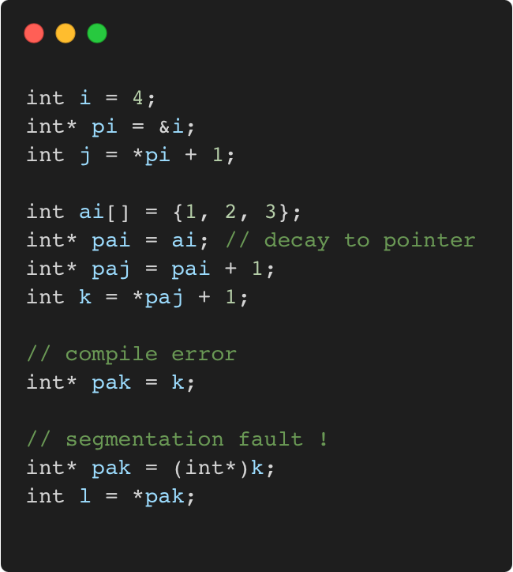
Pointers
C++98
Language Basics | Arrays and Pointers
Gammasoft
Modern C++ Course

Slide 31
Pointers
C++98
Language Basics | Arrays and Pointers
Memory layout
 | 0x3028 300
 | 0x3024
 | 0x3020 300
 | 0x301C
 | 0x3018 300
 | 0x3014
 | 0x3010 300
 | 0x300C
 | 0x3008 300
 | 0x3004
i = 4 | 0x3000 300
Gammasoft
Modern C++ Course

Slide 32
Pointers
C++98
Language Basics | Arrays and Pointers
Memory layout
 | 0x3028 300
 | 0x3024
 | 0x3020 300
 | 0x301C
 | 0x3018 300
 | 0x3014
 | 0x3010 300
 | 0x300C
 | 0x3008 300
pi = 0x3000 | 0x3004
i = 4 | 0x3000 300
Gammasoft
Modern C++ Course

Slide 33
Pointers
C++98
Language Basics | Arrays and Pointers
Memory layout
 | 0x3028 300
 | 0x3024
 | 0x3020 300
 | 0x301C
 | 0x3018 300
 | 0x3014
 | 0x3010 300
 | 0x300C
j = 5 | 0x3008 300
pi = 0x3000 | 0x3004
i = 4 | 0x3000 300
Gammasoft
Modern C++ Course

Slide 34
Pointers
C++98
Language Basics | Arrays and Pointers
Memory layout
 | 0x3028 300
 | 0x3024
 | 0x3020 300
 | 0x301C
 | 0x3018 300
ai[2] = 3 | 0x3014
ai[1] = 2 | 0x3010 300
ai[0] = 1 | 0x300C
j = 5 | 0x3008 300
pi = 0x3000 | 0x3004
i = 4 | 0x3000 300
Gammasoft
Modern C++ Course

Slide 35
Pointers
C++98
Language Basics | Arrays and Pointers
Memory layout
 | 0x3028 300
 | 0x3024
 | 0x3020 300
 | 0x301C
pai = 0x300C | 0x3018 300
ai[2] = 3 | 0x3014
ai[1] = 2 | 0x3010 300
ai[0] = 1 | 0x300C
j = 5 | 0x3008 300
pi = 0x3000 | 0x3004
i = 4 | 0x3000 300
Gammasoft
Modern C++ Course

Slide 36
Pointers
C++98
Language Basics | Arrays and Pointers
Memory layout
 | 0x3028 300
 | 0x3024
 | 0x3020 300
paj = 0x3010 | 0x301C
pai = 0x300C | 0x3018 300
ai[2] = 3 | 0x3014
ai[1] = 2 | 0x3010 300
ai[0] = 1 | 0x300C
j = 5 | 0x3008 300
pi = 0x3000 | 0x3004
i = 4 | 0x3000 300
Gammasoft
Modern C++ Course

Slide 37
Pointers
C++98
Language Basics | Arrays and Pointers
Memory layout
 | 0x3028 300
 | 0x3024
k = 3 | 0x3020 300
paj = 0x3010 | 0x301C
pai = 0x300C | 0x3018 300
ai[2] = 3 | 0x3014
ai[1] = 2 | 0x3010 300
ai[0] = 1 | 0x300C
j = 5 | 0x3008 300
pi = 0x3000 | 0x3004
i = 4 | 0x3000 300
Gammasoft
Modern C++ Course

Slide 38
Pointers
C++98
Language Basics | Arrays and Pointers
Memory layout
 | 0x3028 300
pak = 3 | 0x3024
k = 3 | 0x3020 300
paj = 0x3010 | 0x301C
pai = 0x300C | 0x3018 300
ai[2] = 3 | 0x3014
ai[1] = 2 | 0x3010 300
ai[0] = 1 | 0x300C
j = 5 | 0x3008 300
pi = 0x3000 | 0x3004
i = 4 | 0x3000 300
??
Gammasoft
Modern C++ Course

Slide 39
nullptr
C++11
Language Basics | Arrays and Pointers
if a pointer doesn’t point to anything, set it to nullptr
useful to e.g. mark the end of a linked data structure
or absence of an optional function argument (pointer)
same as setting it to 0 or NULL (before C++ 11)
triggers compilation error when assigned to integer
Gammasoft
Modern C++ Course

Slide 40
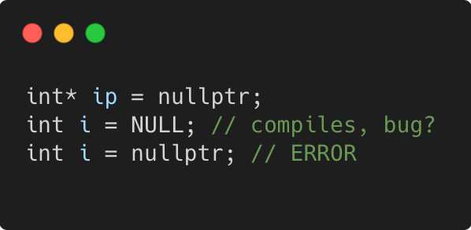
nullptr
C++11
Language Basics | Arrays and Pointers
if a pointer doesn’t point to anything, set it to nullptr
useful to e.g. mark the end of a linked data structure
or absence of an optional function argument (pointer)
same as setting it to 0 or NULL (before C++ 11)
triggers compilation error when assigned to integer
Gammasoft
Modern C++ Course

Slide 41
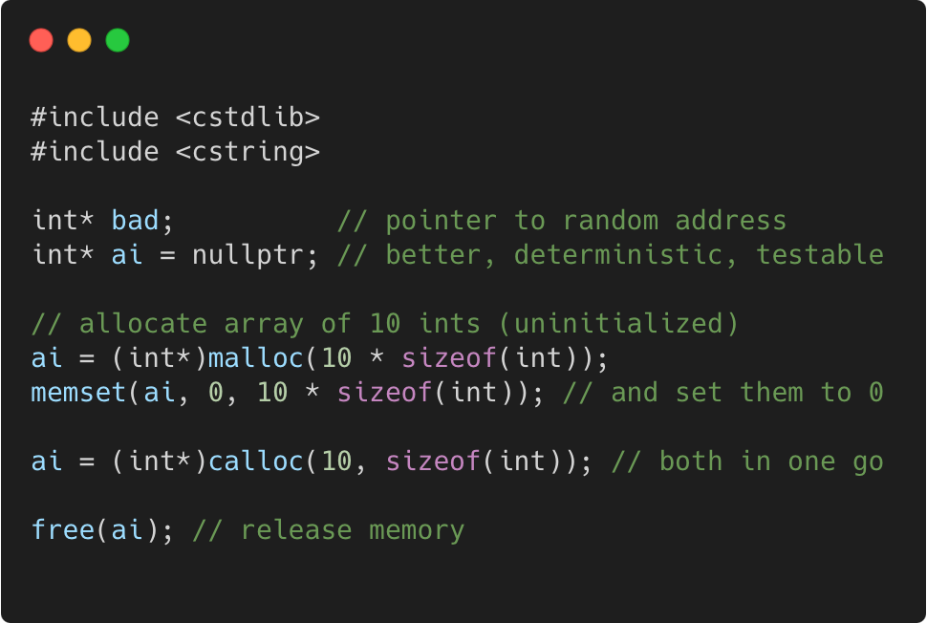
Dynamic arrays using C
C++98
Language Basics | Arrays and Pointers
Gammasoft
Modern C++ Course

Slide 42
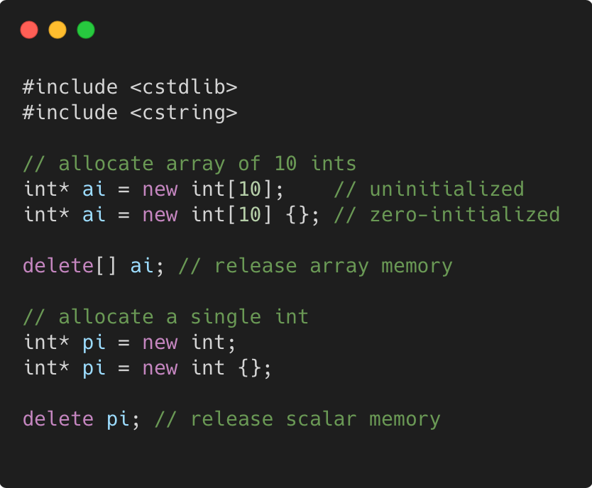
Dynamic arrays using C++
C++98
Language Basics | Arrays and Pointers
Gammasoft
Modern C++ Course

Slide 43
Language Basics
Language Basics
Gammasoft
Modern C++ Course
Hello World
Core syntax and types
Arrays and Pointers
Scopes / namespaces
Class and enum types
References
Functions
Operators
Control structures
Headers and interfaces
Auto keyword
Inline keyword
Assertions

Slide 44
Language Basics
Language Basics
Gammasoft
Modern C++ Course
Hello World
Core syntax and types
Arrays and Pointers
Scopes / namespaces
Class and enum types
References
Functions
Operators
Control structures
Headers and interfaces
Auto keyword
Inline keyword
Assertions

Slide 45
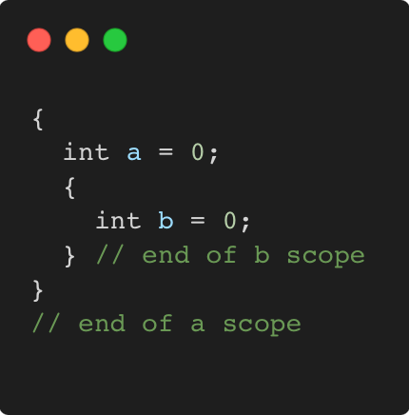
Scope
C++98
Language Basics | Scopes / namespaces
Portion of the source code where a given name is valid
Typically :
simple block of code, within {}
function, class, namespace
the global scope, i.e. translation unit (.cpp file + all includes)
Gammasoft
Modern C++ Course

Slide 46
Scope and lifetime of variables
C++98
Language Basics | Scopes / namespaces
Variables are (statically) allocated when defined
Variables are freed at the end of a scope
Gammasoft
Modern C++ Course

Slide 47
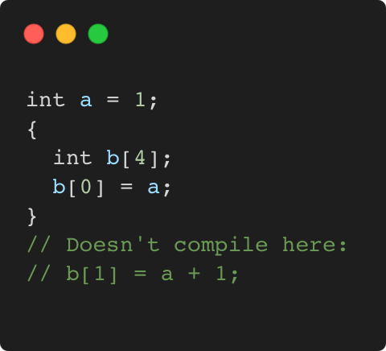
Scope and lifetime of variables
C++98
Language Basics | Scopes / namespaces
Variables are (statically) allocated when defined
Variables are freed at the end of a scope
Gammasoft
Modern C++ Course

Slide 48
Scope and lifetime of variables
C++98
Language Basics | Scopes / namespaces
Variables are (statically) allocated when defined
Variables are freed at the end of a scope
Memory layout
 | 0x3010
 | 0x300C
 | 0x3008
 | 0x3004
i = 4 | 0x3000
Gammasoft
Modern C++ Course

Slide 49
Scope and lifetime of variables
C++98
Language Basics | Scopes / namespaces
Variables are (statically) allocated when defined
Variables are freed at the end of a scope
Memory layout
b[3] = ? | 0x3010
b[2] = ? | 0x300C
b[1] = ? | 0x3008
b[0] = ? | 0x3004
i = 4 | 0x3000
Gammasoft
Modern C++ Course

Slide 50
Scope and lifetime of variables
C++98
Language Basics | Scopes / namespaces
Variables are (statically) allocated when defined
Variables are freed at the end of a scope
Memory layout
b[3] = ? | 0x3010
b[2] = ? | 0x300C
b[1] = ? | 0x3008
b[0] = 1 | 0x3004
i = 4 | 0x3000
Gammasoft
Modern C++ Course

Slide 51
Scope and lifetime of variables
C++98
Language Basics | Scopes / namespaces
Variables are (statically) allocated when defined
Variables are freed at the end of a scope
Memory layout
? | 0x3010
? | 0x300C
? | 0x3008
1 | 0x3004
i = 4 | 0x3000
Gammasoft
Modern C++ Course

Slide 52
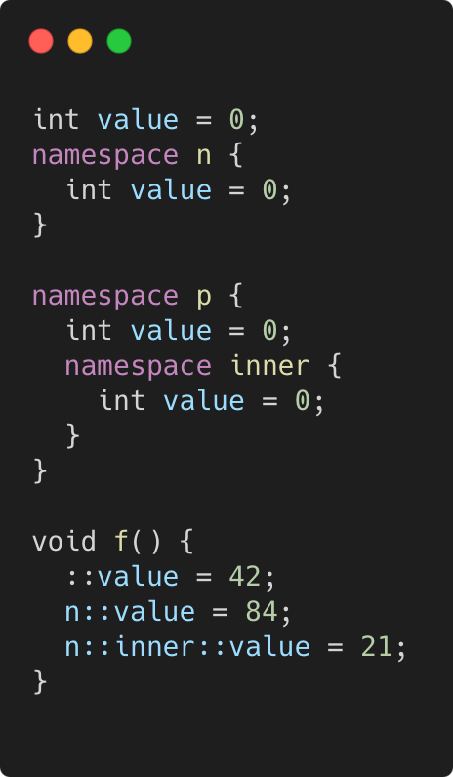
Namepaces
C++98
Language Basics | Scopes / namespaces
Namespaces allow to segment your code to avoid name clashes
They can be embedded to create hierarchies (separator is ::)
Gammasoft
Modern C++ Course

Slide 53
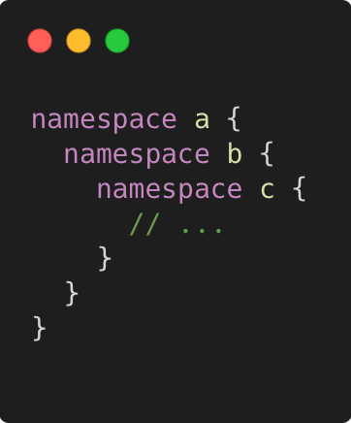
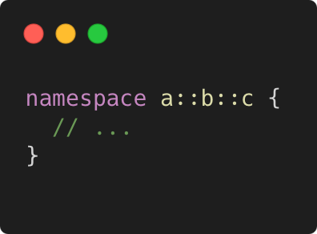
Nested namespaces
C++17
Language Basics | Scopes / namespaces
Easier way to declare nested namespaces
C++98
C++17
Gammasoft
Modern C++ Course

Slide 54
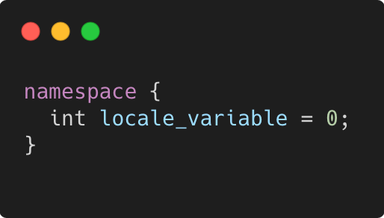
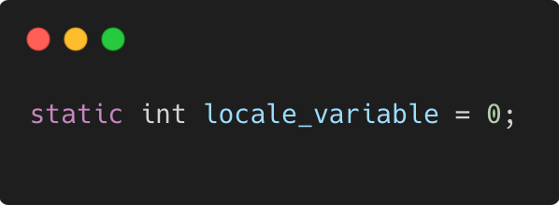
Anonymous namespace
C++98
Language Basics | Scopes / namespaces
groups a number of declarations
visible only in the current translation unit
but not reusable outside
allows much better compiler optimizations and checking
e.g. unused function warning
context dependent optimizations
equivalent
Gammasoft
Modern C++ Course

Slide 55
Language Basics
Language Basics
Gammasoft
Modern C++ Course
Hello World
Core syntax and types
Arrays and Pointers
Scopes / namespaces
Class and enum types
References
Functions
Operators
Control structures
Headers and interfaces
Auto keyword
Inline keyword
Assertions

Slide 56
Language Basics
Language Basics
Gammasoft
Modern C++ Course
Hello World
Core syntax and types
Arrays and Pointers
Scopes / namespaces
Class and enum types
References
Functions
Operators
Control structures
Headers and interfaces
Auto keyword
Inline keyword
Assertions

Slide 57
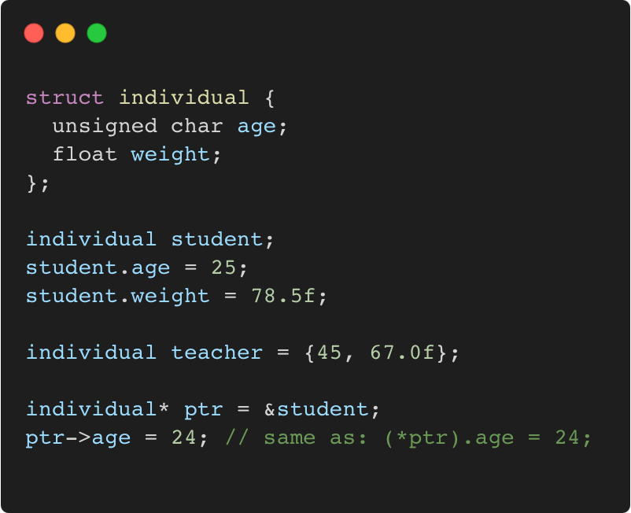
Struct
C++98
Language Basics | Class and enum types
“members” grouped together under one name
Gammasoft
Modern C++ Course

Slide 58
Struct
C++98
Language Basics | Class and enum types
“members” grouped together under one name
Memory layout
 |  |  |  | 0x3010
 |  |  |  | 0x300C
 |  |  |  | 0x3008
 |  |  |  | 0x3004
 |  |  |  | 0x3000
Gammasoft
Modern C++ Course

Slide 59
Struct
C++98
Language Basics | Class and enum types
“members” grouped together under one name
Memory layout
 |  |  |  | 0x3010
 |  |  |  | 0x300C
 |  |  |  | 0x3008
? | ? | ? | ? | 0x3004
? | ? | ? | ? | 0x3000
{
Student
Gammasoft
Modern C++ Course

Slide 60
Struct
C++98
Language Basics | Class and enum types
“members” grouped together under one name
Memory layout
 |  |  |  | 0x3010
 |  |  |  | 0x300C
 |  |  |  | 0x3008
? | ? | ? | ? | 0x3004
25 | ? | ? | ? | 0x3000
{
Student
Gammasoft
Modern C++ Course

Slide 61
Struct
C++98
Language Basics | Class and enum types
“members” grouped together under one name
Memory layout
 |  |  |  | 0x3010
 |  |  |  | 0x300C
 |  |  |  | 0x3008
 |  |  |  | 0x3004
25 | ? | ? | ? | 0x3000
{
78.5
Student
Gammasoft
Modern C++ Course

Slide 62
Struct
C++98
Language Basics | Class and enum types
“members” grouped together under one name
Memory layout
 |  |  |  | 0x3010
 |  |  |  | 0x300C
45 | ? | ? | ? | 0x3008
 |  |  |  | 0x3004
25 | ? | ? | ? | 0x3000
{
67.0
Teacher
{
78.5
Student
Gammasoft
Modern C++ Course

Slide 63
Struct
C++98
Language Basics | Class and enum types
“members” grouped together under one name
Memory layout
 |  |  |  | 0x3010
 |  |  |  | 0x300C
45 | ? | ? | ? | 0x3008
 |  |  |  | 0x3004
25 | ? | ? | ? | 0x3000
0x3000
{
67.0
Teacher
{
78.5
Student
Gammasoft
Modern C++ Course

Slide 64
Struct
C++98
Language Basics | Class and enum types
“members” grouped together under one name
Memory layout
 |  |  |  | 0x3010
 |  |  |  | 0x300C
45 | ? | ? | ? | 0x3008
 |  |  |  | 0x3004
24 | ? | ? | ? | 0x3000
0x3000
{
67.0
Teacher
{
78.5
Student
Gammasoft
Modern C++ Course

Slide 65
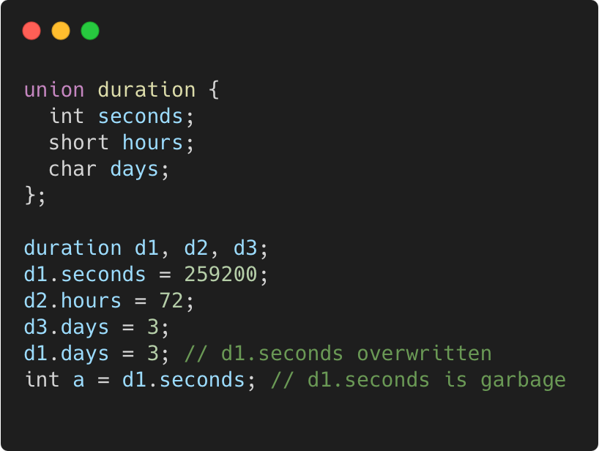
Union
C++98
Language Basics | Class and enum types
“members” packed together at same memory location
Gammasoft
Modern C++ Course

Slide 66
Union
C++98
Language Basics | Class and enum types
“members” packed together at same memory location
Memory layout
 |  |  |  | 0x300C
 |  |  |  | 0x3008
 |  |  |  | 0x3004
 |  |  |  | 0x3000
Gammasoft
Modern C++ Course

Slide 67
Union
C++98
Language Basics | Class and enum types
“members” packed together at same memory location
Memory layout
 |  |  |  | 0x300C
? | ? | ? | ? | 0x3008
? | ? | ? | ? | 0x3004
? | ? | ? | ? | 0x3000
Gammasoft
Modern C++ Course

Slide 68
Union
C++98
Language Basics | Class and enum types
“members” packed together at same memory location
Memory layout
 |  |  |  | 0x300C
? | ? | ? | ? | 0x3008
? | ? | ? | ? | 0x3004
 |  |  |  | 0x3000
259200
Gammasoft
Modern C++ Course

Slide 69
Union
C++98
Language Basics | Class and enum types
“members” packed together at same memory location
Memory layout
 |  |  |  | 0x300C
? | ? | ? | ? | 0x3008
 |  | ? | ? | 0x3004
 |  |  |  | 0x3000
72
259200
Gammasoft
Modern C++ Course

Slide 70
Union
C++98
Language Basics | Class and enum types
“members” packed together at same memory location
Memory layout
 |  |  |  | 0x300C
3 | ? | ? | ? | 0x3008
 |  | ? | ? | 0x3004
 |  |  |  | 0x3000
72
259200
Gammasoft
Modern C++ Course

Slide 71
Union
C++98
Language Basics | Class and enum types
“members” packed together at same memory location
Memory layout
 |  |  |  | 0x300C
3 | ? | ? | ? | 0x3008
 |  | ? | ? | 0x3004
3 | ? | ? | ? | 0x3000
72
Gammasoft
Modern C++ Course

Slide 72
Union
C++98
Language Basics | Class and enum types
“members” packed together at same memory location
Memory layout
? | ? | ? | ? | 0x300C
3 | ? | ? | ? | 0x3008
 |  | ? | ? | 0x3004
3 | ? | ? | ? | 0x3000
72
Gammasoft
Modern C++ Course

Slide 73
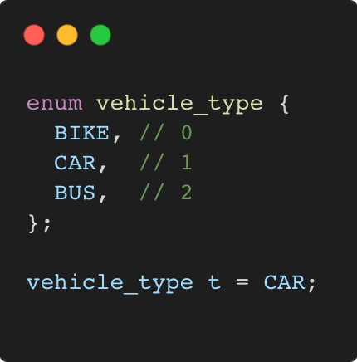
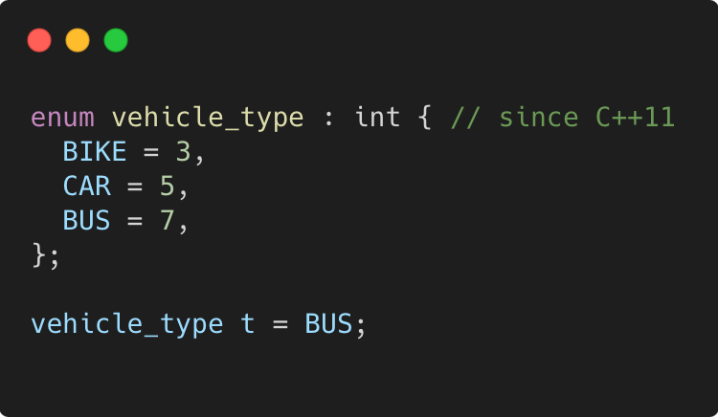
Enum
C++98
Language Basics | Class and enum types
use to declare a list of related constants (enumerators)
has an underlying integral type
enumerator names leak into enclosing scope
Gammasoft
Modern C++ Course

Slide 74
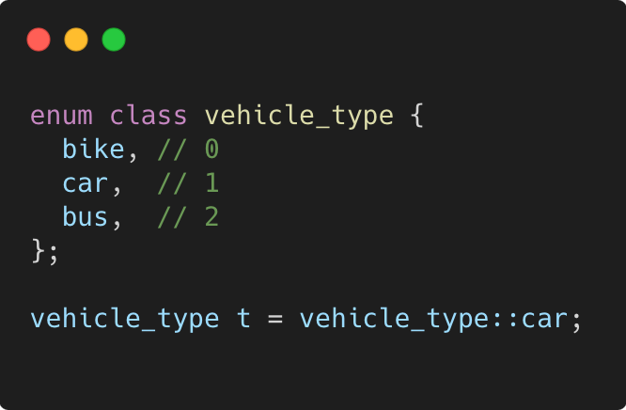
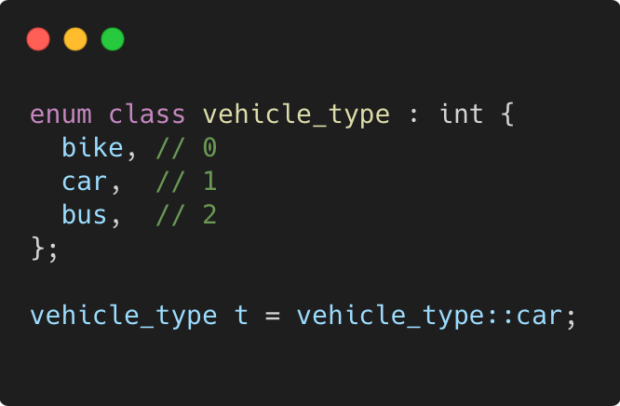
Enum class
C++11
Language Basics | Class and enum types
scopes enumerator names, avoids name clashes
strong typing, no automatic conversion to int
Gammasoft
Modern C++ Course

Slide 75
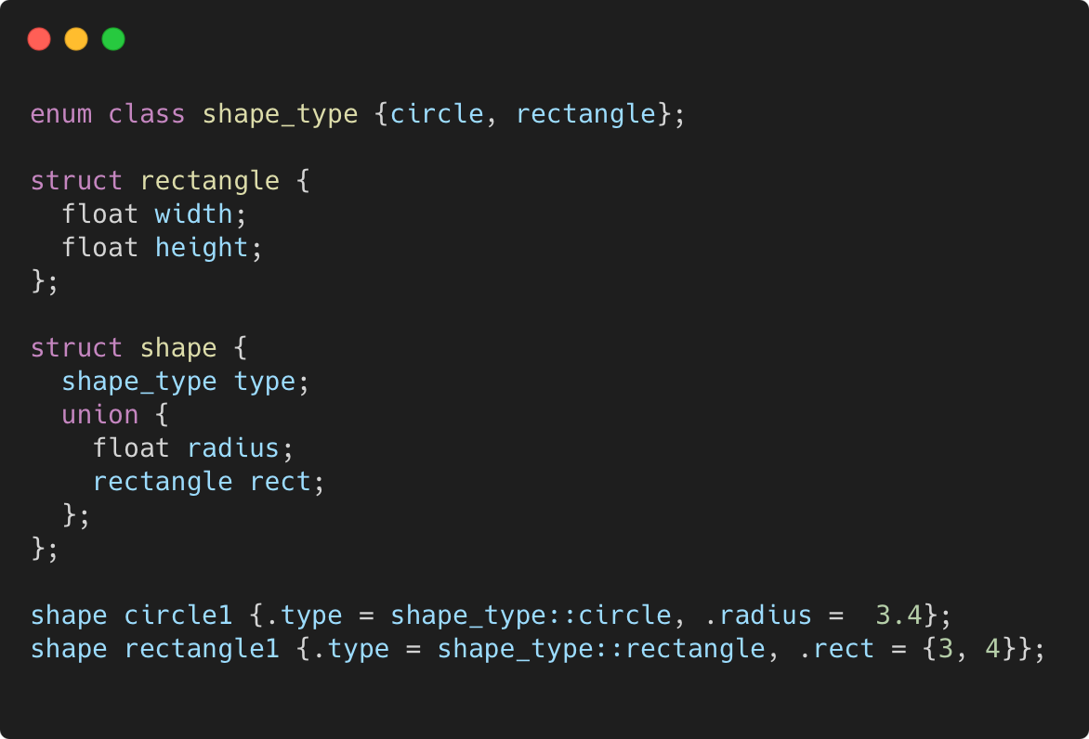
More concrete example
C++11
Language Basics | Class and enum types
Gammasoft
Modern C++ Course

Slide 76
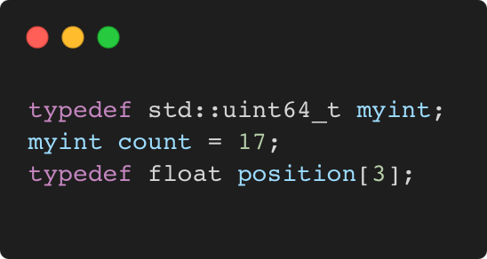
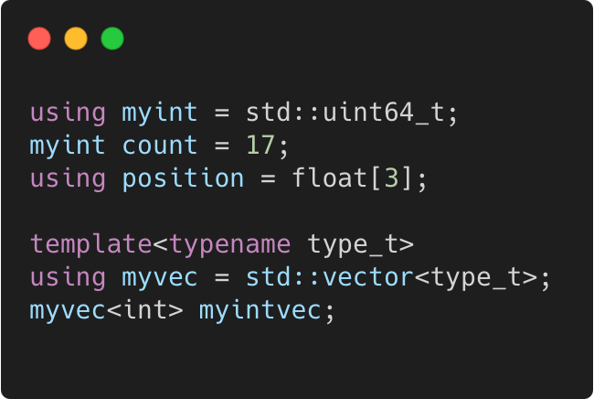
typedef and using
C++98 / C++11
Language Basics | Class and enum types
C++98
C++11
Gammasoft
Modern C++ Course

Slide 77
Language Basics
Language Basics
Gammasoft
Modern C++ Course
Hello World
Core syntax and types
Arrays and Pointers
Scopes / namespaces
Class and enum types
References
Functions
Operators
Control structures
Headers and interfaces
Auto keyword
Inline keyword
Assertions

Slide 78
Language Basics
Language Basics
Gammasoft
Modern C++ Course
Hello World
Core syntax and types
Arrays and Pointers
Scopes / namespaces
Class and enum types
References
Functions
Operators
Control structures
Headers and interfaces
Auto keyword
Inline keyword
Assertions

Slide 79
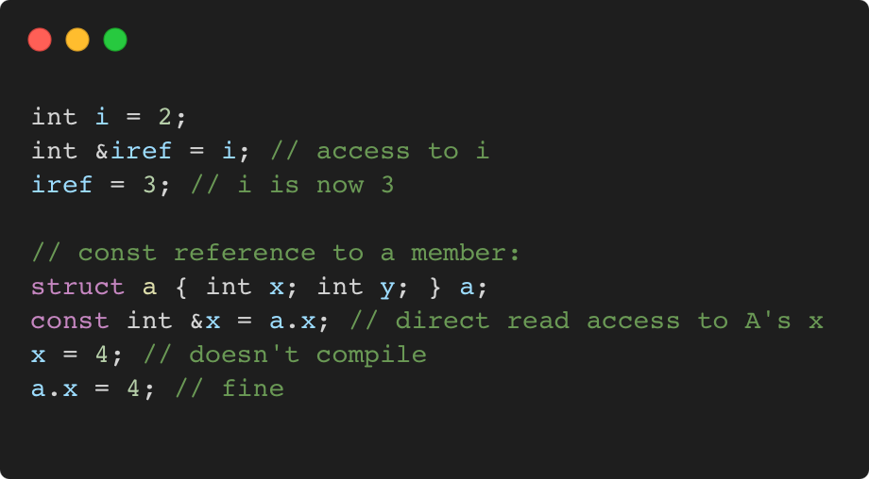
References
C++98
Language Basics | Class and enum types
References allow for direct access to another object
They can be used as shortcuts / better readability
They can be declared const to allow only read access
Gammasoft
Modern C++ Course

Slide 80
References vs pointers
C++98
Language Basics | Class and enum types
Natural syntax
Cannot be null
Must be assigned when defined, cannot be reassigned
Prefer using references instead of pointers
Mark references const to prevent modification
Gammasoft
Modern C++ Course

Slide 81
Language Basics
Language Basics
Gammasoft
Modern C++ Course
Hello World
Core syntax and types
Arrays and Pointers
Scopes / namespaces
Class and enum types
References
Functions
Operators
Control structures
Headers and interfaces
Auto keyword
Inline keyword
Assertions

Slide 82
Language Basics
Language Basics
Gammasoft
Modern C++ Course
Hello World
Core syntax and types
Arrays and Pointers
Scopes / namespaces
Class and enum types
References
Functions
Operators
Control structures
Headers and interfaces
Auto keyword
Inline keyword
Assertions

Slide 83
Language Basics
Language Basics
Gammasoft
Modern C++ Course
Hello World
Core syntax and types
Arrays and Pointers
Scopes / namespaces
Class and enum types
References
Functions
Operators
Control structures
Headers and interfaces
Auto keyword
Inline keyword
Assertions

Slide 84
Language Basics
Language Basics
Gammasoft
Modern C++ Course
Hello World
Core syntax and types
Arrays and Pointers
Scopes / namespaces
Class and enum types
References
Functions
Operators
Control structures
Headers and interfaces
Auto keyword
Inline keyword
Assertions

Slide 85
Language Basics
Language Basics
Gammasoft
Modern C++ Course
Hello World
Core syntax and types
Arrays and Pointers
Scopes / namespaces
Class and enum types
References
Functions
Operators
Control structures
Headers and interfaces
Auto keyword
Inline keyword
Assertions

Slide 86
Language Basics
Language Basics
Gammasoft
Modern C++ Course
Hello World
Core syntax and types
Arrays and Pointers
Scopes / namespaces
Class and enum types
References
Functions
Operators
Control structures
Headers and interfaces
Auto keyword
Inline keyword
Assertions

Slide 87
Language Basics
Language Basics
Gammasoft
Modern C++ Course
Hello World
Core syntax and types
Arrays and Pointers
Scopes / namespaces
Class and enum types
References
Functions
Operators
Control structures
Headers and interfaces
Auto keyword
Inline keyword
Assertions

Slide 88
Language Basics
Language Basics
Gammasoft
Modern C++ Course
Hello World
Core syntax and types
Arrays and Pointers
Scopes / namespaces
Class and enum types
References
Functions
Operators
Control structures
Headers and interfaces
Auto keyword
Inline keyword
Assertions

Slide 89
Language Basics
Language Basics
Gammasoft
Modern C++ Course
Hello World
Core syntax and types
Arrays and Pointers
Scopes / namespaces
Class and enum types
References
Functions
Operators
Control structures
Headers and interfaces
Auto keyword
Inline keyword
Assertions

Slide 90
Language Basics
Language Basics
Gammasoft
Modern C++ Course
Hello World
Core syntax and types
Arrays and Pointers
Scopes / namespaces
Class and enum types
References
Functions
Operators
Control structures
Headers and interfaces
Auto keyword
Inline keyword
Assertions

Slide 91
Language Basics
Language Basics
Gammasoft
Modern C++ Course
Hello World
Core syntax and types
Arrays and Pointers
Scopes / namespaces
Class and enum types
References
Functions
Operators
Control structures
Headers and interfaces
Auto keyword
Inline keyword
Assertions

Slide 92
Language Basics
Language Basics
Gammasoft
Modern C++ Course
Hello World
Core syntax and types
Arrays and Pointers
Scopes / namespaces
Class and enum types
References
Functions
Operators
Control structures
Headers and interfaces
Auto keyword
Inline keyword
Assertions

Slide 93
Language Basics
Language Basics
Gammasoft
Modern C++ Course
Hello World
Core syntax and types
Arrays and Pointers
Scopes / namespaces
Class and enum types
References
Functions
Operators
Control structures
Headers and interfaces
Auto keyword
Inline keyword
Assertions

Slide 94
Language Basics
Language Basics
Gammasoft
Modern C++ Course
Hello World
Core syntax and types
Arrays and Pointers
Scopes / namespaces
Class and enum types
References
Functions
Operators
Control structures
Headers and interfaces
Auto keyword
Inline keyword
Assertions

Slide 95
Language Basics
Language Basics
Gammasoft
Modern C++ Course
Hello World
Core syntax and types
Arrays and Pointers
Scopes / namespaces
Class and enum types
References
Functions
Operators
Control structures
Headers and interfaces
Auto keyword
Inline keyword
Assertions

Slide 96
Language Basics
Language Basics
Gammasoft
Modern C++ Course
Hello World
Core syntax and types
Arrays and Pointers
Scopes / namespaces
Class and enum types
References
Functions
Operators
Control structures
Headers and interfaces
Auto keyword
Inline keyword
Assertions

Slide 97
Language Basics
Language Basics
Gammasoft
Modern C++ Course
Hello World
Core syntax and types
Arrays and Pointers
Scopes / namespaces
Class and enum types
References
Functions
Operators
Control structures
Headers and interfaces
Auto keyword
Inline keyword
Assertions

Slide 98
Outline
Introduction
Language Basics
Object Oriented Programming (OOP)
Core Modern C++
Modern C++ Expert
Advanced Programming
Gammasoft
Modern C++ Course

Slide 99
End
Gammasoft
Modern C++ Course

